Slide 1
Environment Development Assessment 4
Asish Sharma

Slide 2
Introduction
Introduction:
This assessment will examine the processes of planning, designing and creating an environment, using simple and efficient 3D asset, in line with a brief, involving the use of a real-time engine.
The assessment will include:
Analysing a brief.
Gathering reference and developing an environmental concepts.
Editing asset lists and setting naming conventions.
Modelling, UV unwrapping and texturing objects for the environment.
Building, Lighting and presenting the environment in a real-time engine.
Gathering and addressing feedback and conducting a post mortem review.
The assessment instructions:
All sections marked in green must be edited/filled out by each student. Be sure to replace “Student Name” on the first slide and the in the document title with your name.

Slide 3
Brief|Overview & Requirements
Overview:
Utilising polygon modelling techniques create an asset suitable for a game engine
to be uploaded into either a game engine, Sketchfab or similar.
Models:
Your mesh topology and UV layouts must be clean and efficient.
Textures:
Textures must meet the technical requirements set in the the asset list.
Textures are to be exported in an appropriate format. E.g. PNG. JPG. TGA. etc.
Presentation:
The final level is to be uploaded to real time engine and lit appropriately.

Slide 4
Task|Description
Description Task:
Considering the brief, write a description of what your environment will be about (100 Words).
Eg, A battered old street, The windows are barred, and doors locked. Rubbish is strewn all over the floor. A war of words is played out in the graffiti on the walls. The light seems to have traveled a while to be here and is quickly trying to take a breath of air before running away., leaving dark shadows and murky lights. Near the end of the street is a building that looks clean in comparison, yet still dirty. Lights are coming from behind the barred windows and the door looks open and inviting. Calm music is playing from within.
Include:
The location
What time is it
Future, past, present
Morning, noon, night
Genre
Colour palette
Asset List:
Set up a list of assets, updating the naming conventions for your asset and its associated textures on the next slide. Duplicate the slide for more assets

Slide 5
Description/Asset List
Asset | Polycount | Textures | Tex. Size | Texture Name | Description
AsishSharma_Bridge_Tunnel_Textured.fbx | <1500 Tri’s | Diffuse (Alpha) Specular Normal | 1024 1024 1024 | TowerFoundation_Texture1.jpg TowerFoundation_Texture2.jpg | Golden Gate Bridge
AsishSharma_Boat.fbx | <1500 Tri’s | Diffuse (Alpha) Specular Normal | 1024 1024 1024 | BoatUV_Texture.psd | Wooden Boat
AsishSharma_Tunnel_Sign.fbx |  |  |  | TunnelSign_Texture.jpg | Tunnel Sign

Slide 6
Task|Reference
Reference Tasks:
Gather reference images for your asset, include material reference and consider the colour palette. Paste the images into the slide below.
Requirements:
Add notes where relevant and crop images so that they only include the important elements.

Slide 7

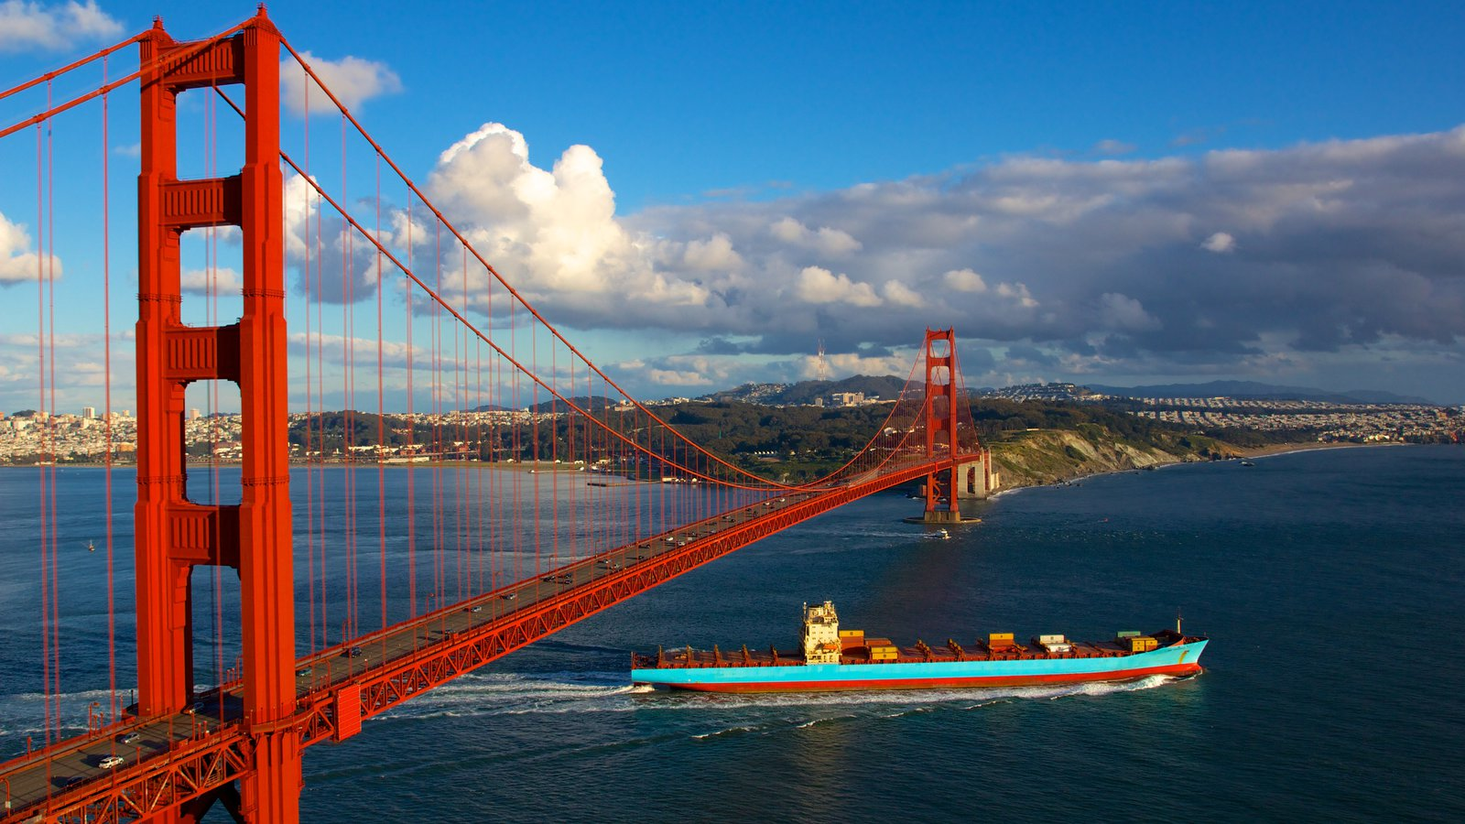
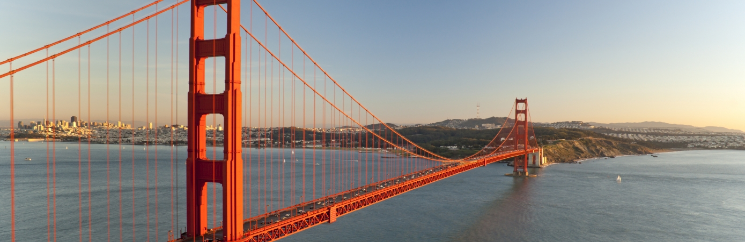
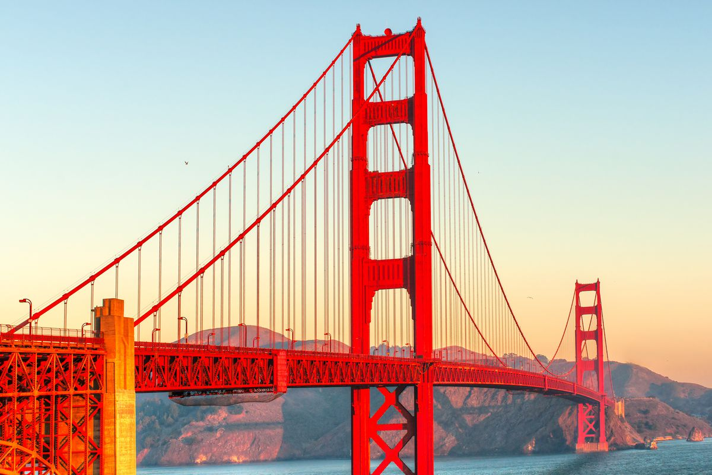

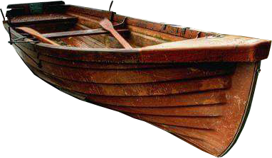
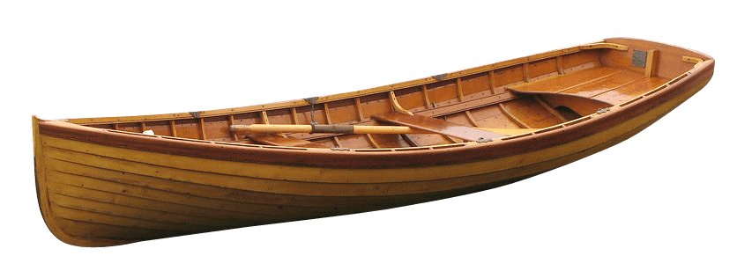
Reference
Paste your images into the green box

Slide 8
Task|Concepting
Concepting Tasks:
Create a 3 rough thumbnail sketches for your environment
Create at least 1-2 thumbnail sketches of each key asset
These are the key assets
paste them into the slide below.
Requirements:
Thumbnails must include the overall form and major details.

Slide 9
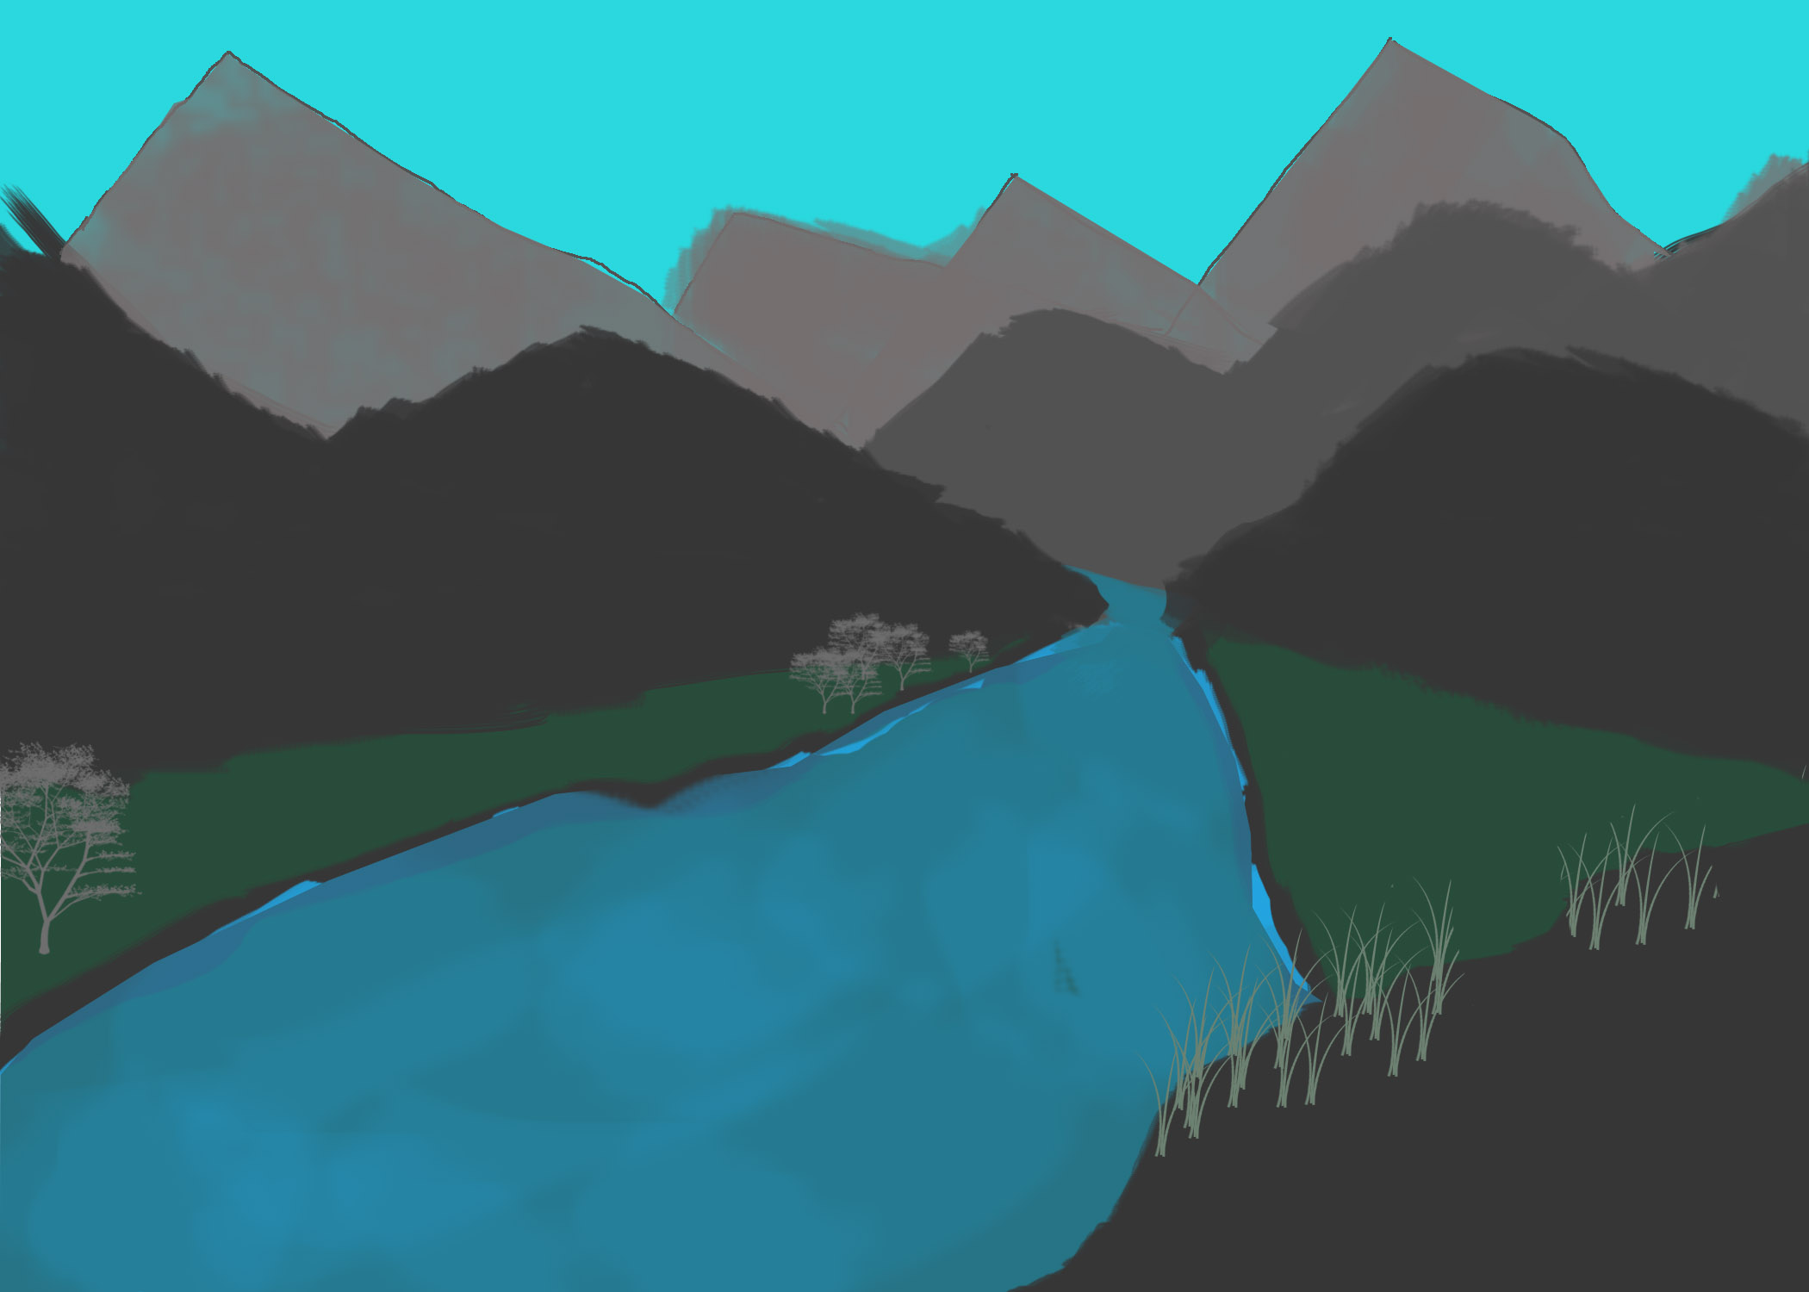
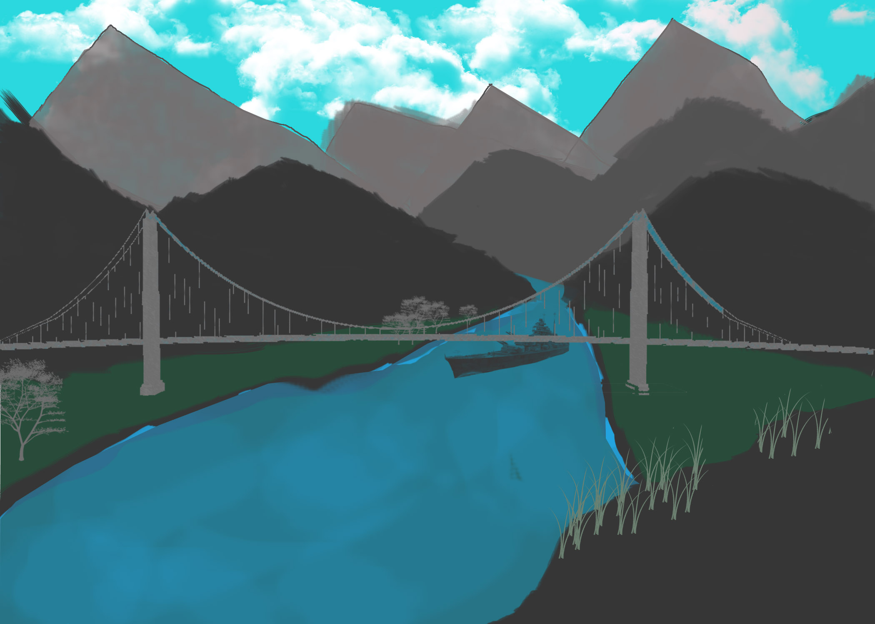
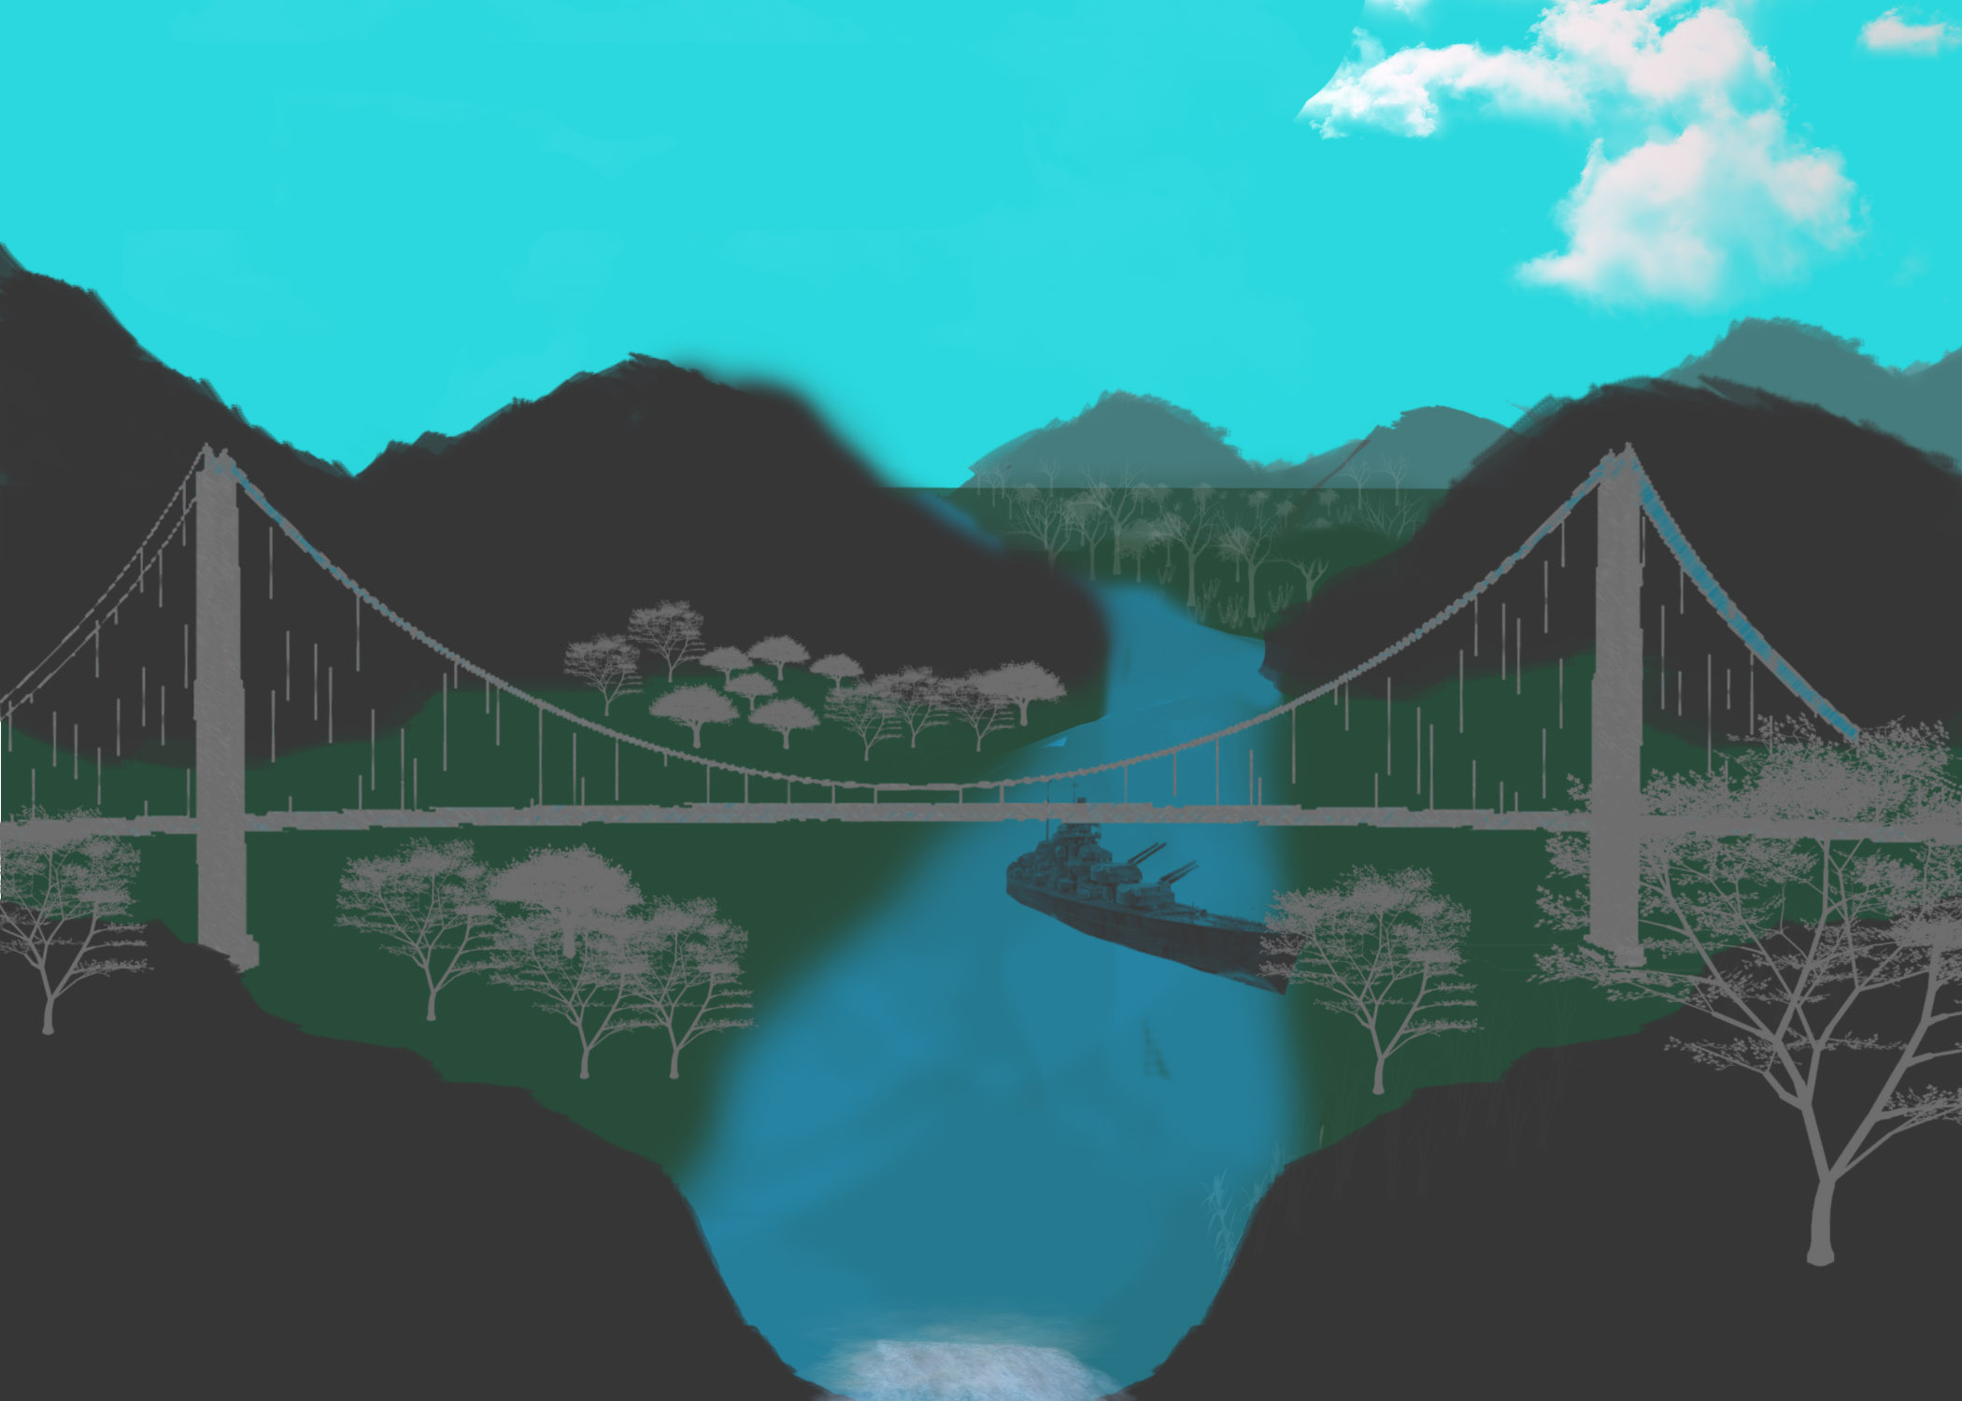
Thumbnails - Environment
Paste your images in the green boxes

Slide 10
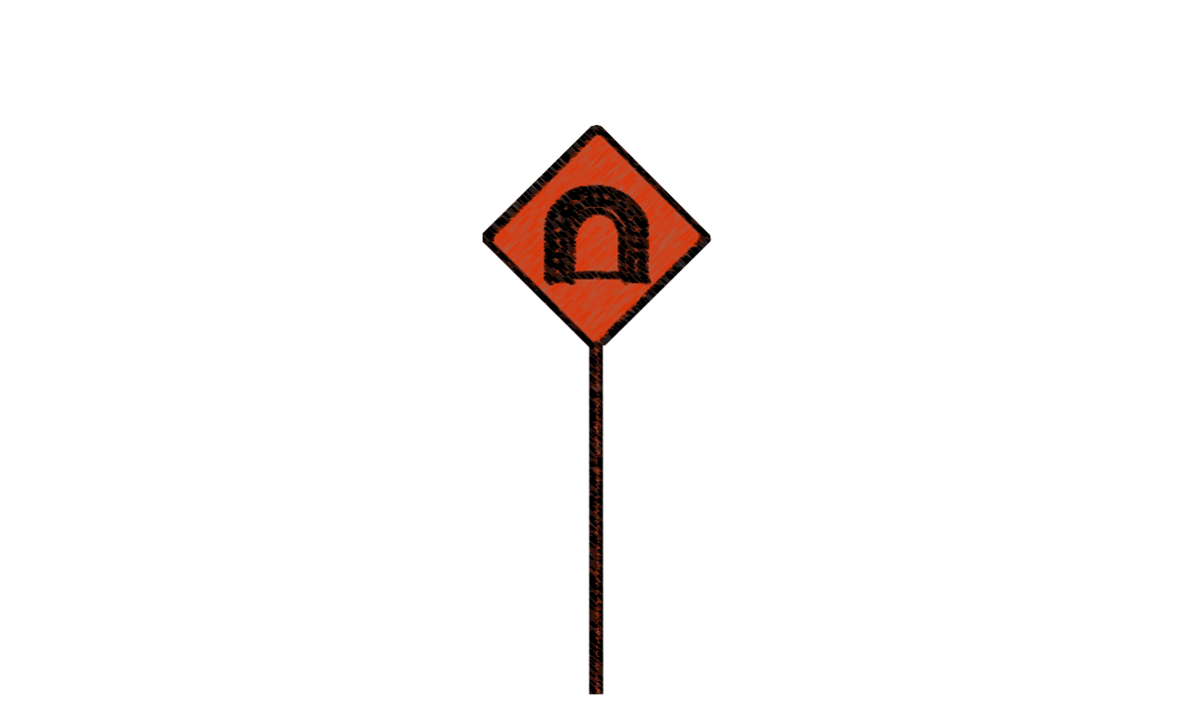
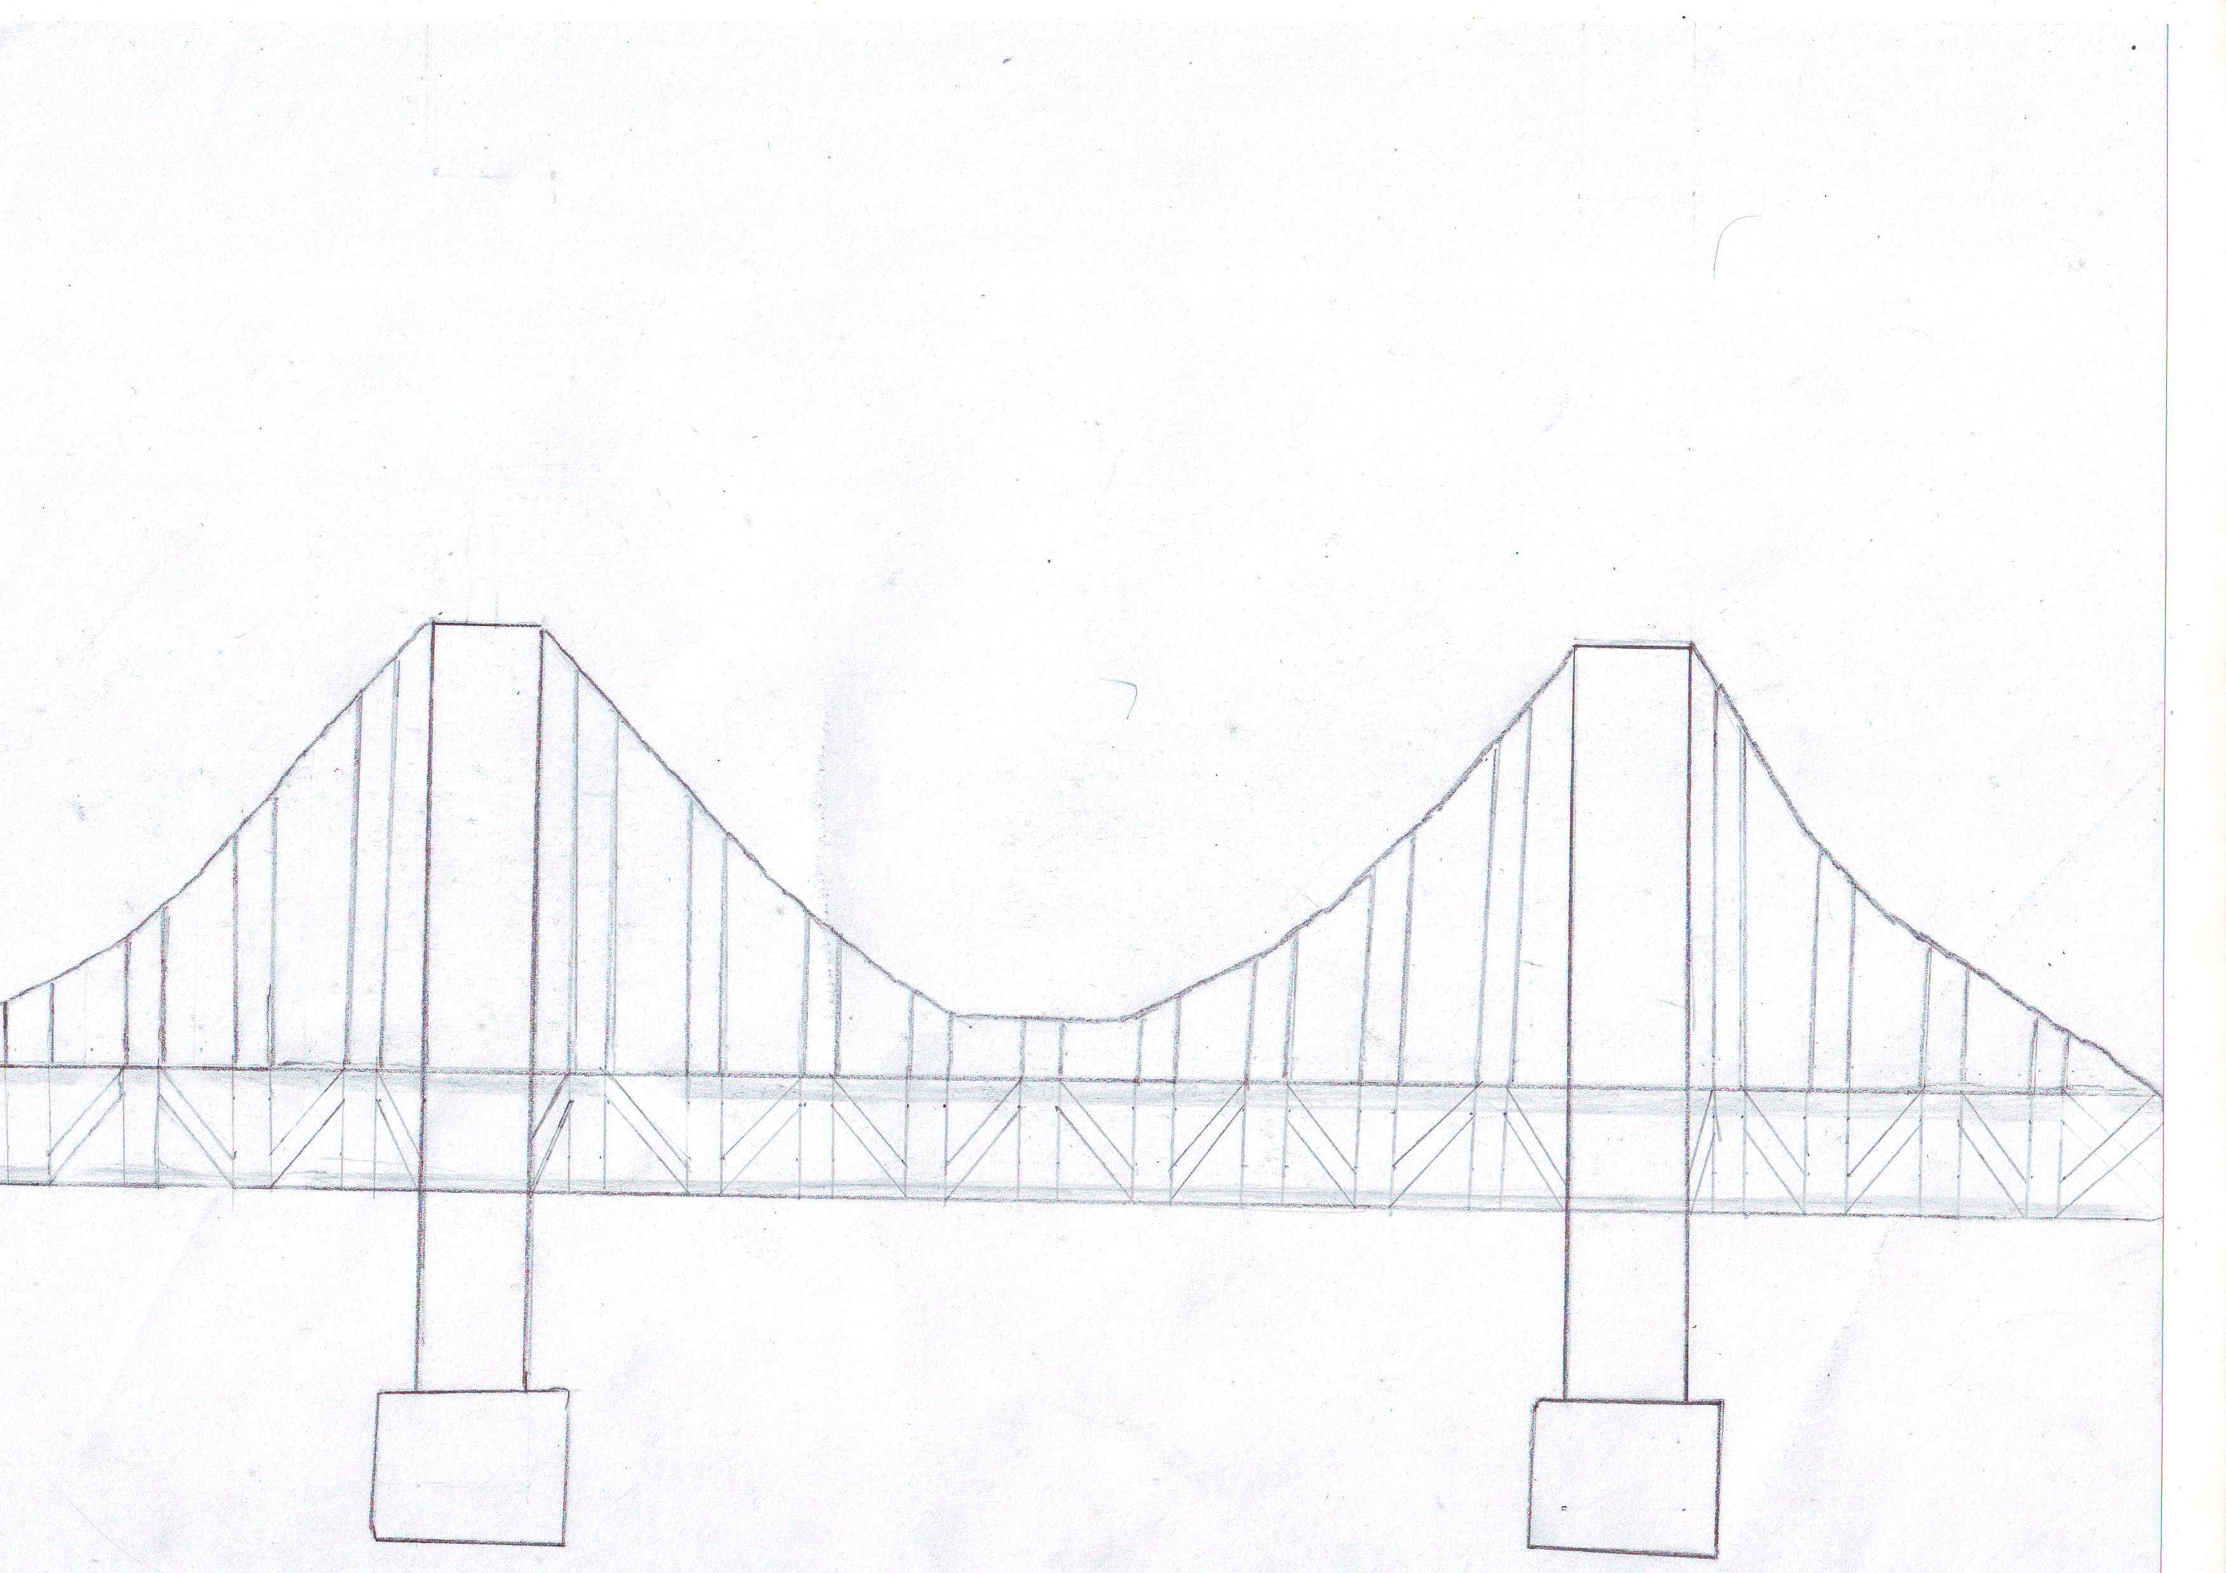
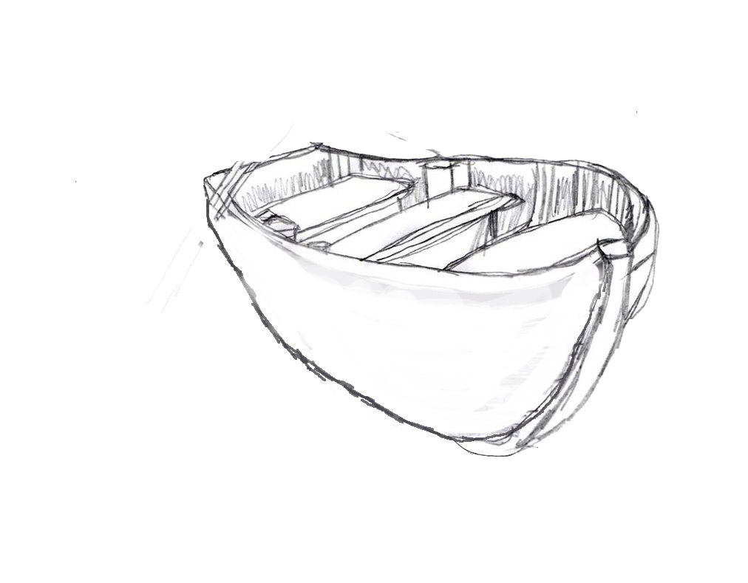
Thumbnails - Key Assets
Paste your images in the green boxes

Slide 11
Task|Primitive Blockout
Blockout Tasks:
In Maya
Using only primitives create a primitive blockout of your assets.
In the game engine
Use primitive blocks and meshes to block out your level
Include your primitive maya blocks
Screen capture at least three views in the level and paste them into the slide below.
Requirements:
The blockout should be the correct scale and represent the key forms of the design.

Slide 12
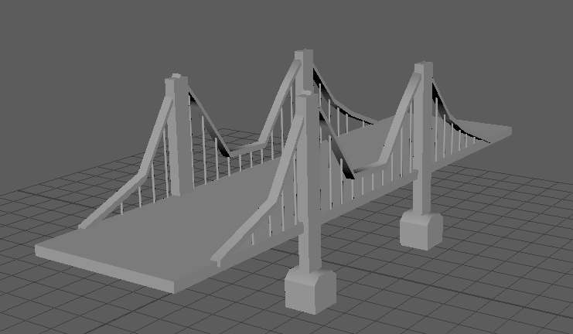
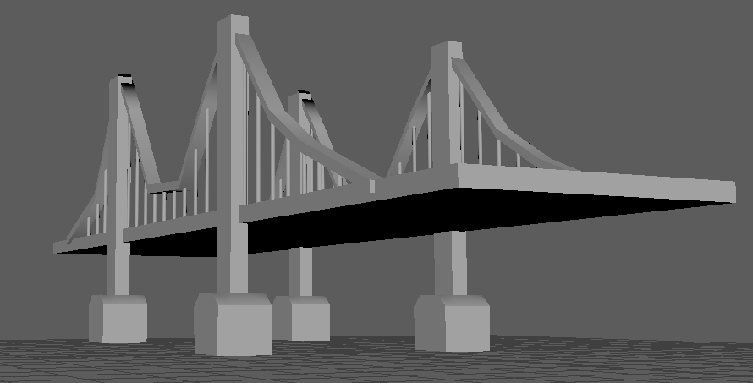
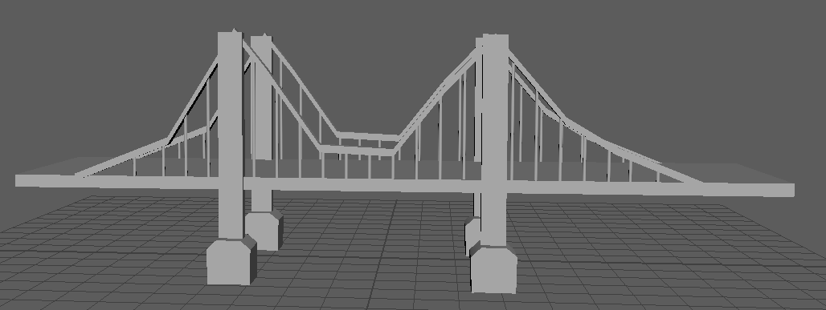
Primitives Blockout
Paste your images in the green boxes
Level view 1
Level view 2
Level view 3

Slide 13
Feedback|Pre-production
Obtain approval for your pre-production before modelling your asset.
Feedback | Approved

Slide 14
Task|Modelling
Modelling Tasks:
In Maya create your asset using polygon modelling techniques.
Take two of your best models for the environment
Screen capture a perspective view of the model in shaded wireframe mode and paste it into the slide below.
UV Unwrap your mask model.
Take a UV snapshot of your mask’s UV layout and paste it into the slide below.
Bring the newly created assets into the game engine
Take a snapshot of 3 different views
Requirements:
Your mesh must meet the brief and technical requirements.
Your mesh needs to be clean with efficient topology.
Use Mesh Cleanup and remove/fix any: N-gons, Hidden edges, Lamina faces or Isolated vertices.
Delete your history, freeze transforms, set your pivots, clean your outliner and ensure your Mesh is named appropriately.

Slide 15
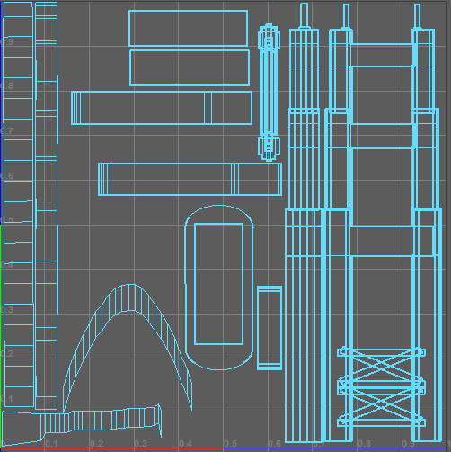
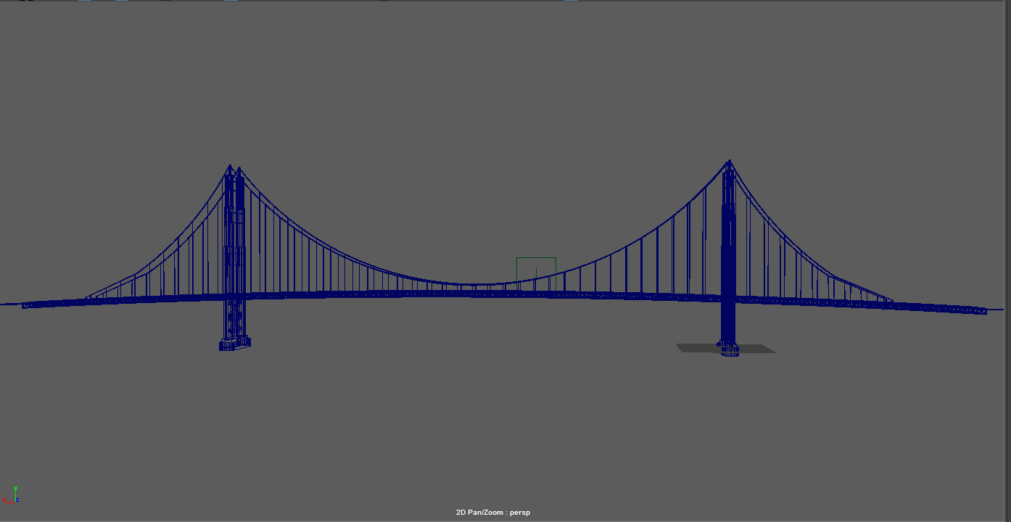
Modelling & UV|Asset 1
Paste your images in the green boxes
Perspective shaded wireframe
UV Snapshot

Slide 16
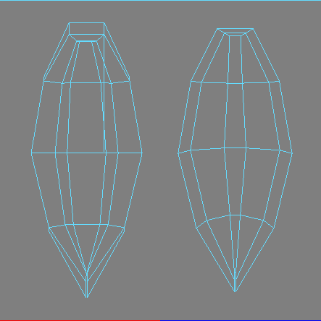
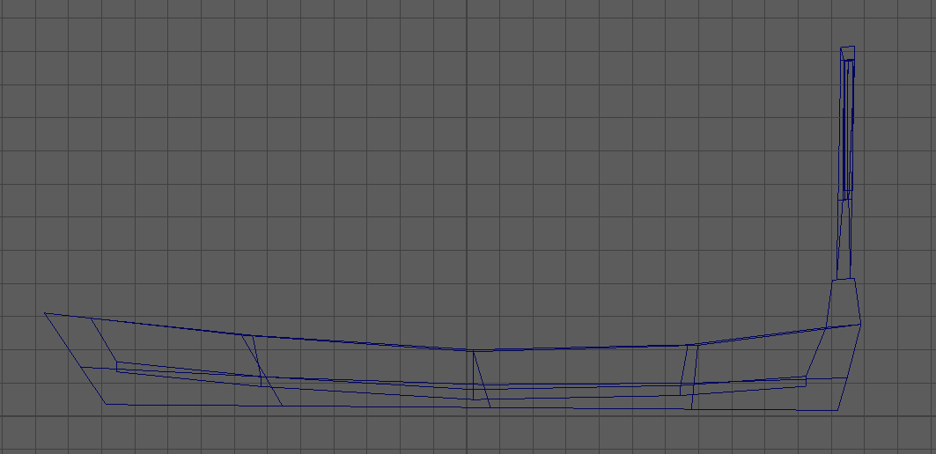
Modelling & UV|Asset 2
Paste your images in the green boxes
Perspective shaded wireframe
UV Snapshot

Slide 17
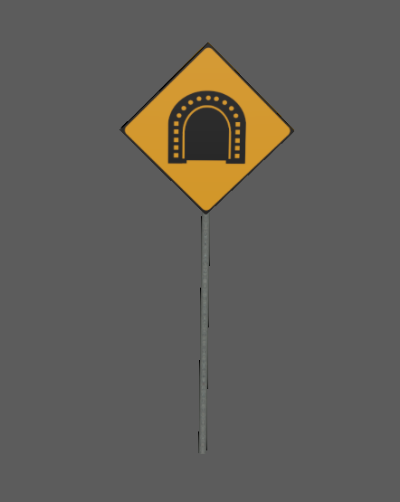
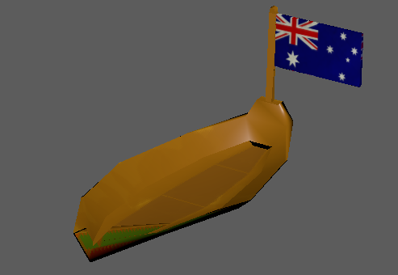
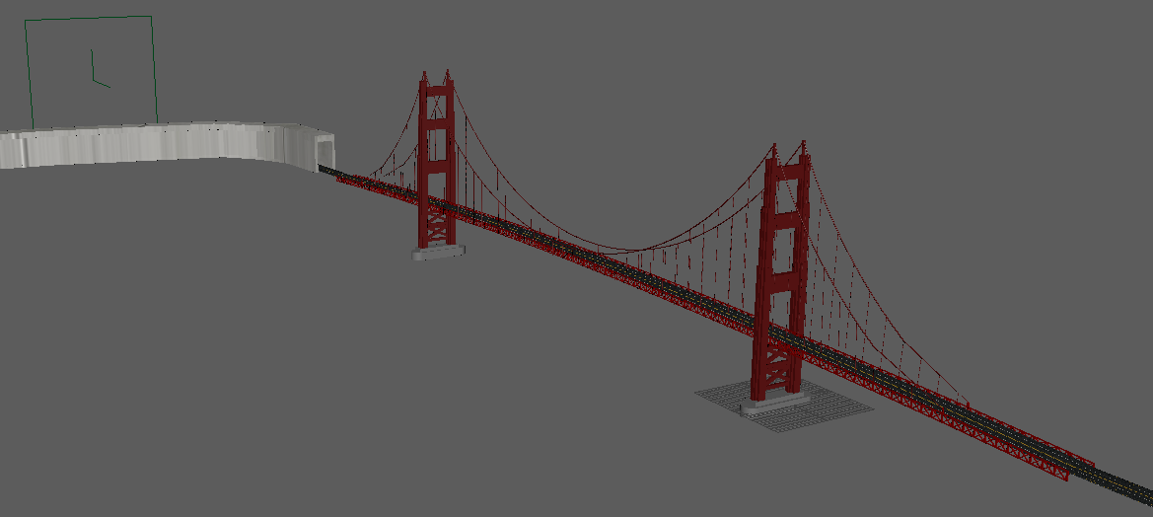
Modeling Level shots
Paste your images in the green boxes
Level view 1
Level view 2
Level view 3

Slide 18
Feedback|Modelling
Obtain approval for your model and UV unwrap before texturing your asset.
Feedback | Approved

Slide 19
Task|Texturing
Texturing Tasks:
Take two other assets
Gather or create images to create the required texture maps.
Paste the textures into the slide below.
Screen capture a perspective view of the model with the textures applied and paste it into the slide below.
Maps required:
Diffuse map
Normal map
Requirements:
Export your individual maps in an appropriate format using the naming conventions set in the asset list.
Ensure your model uses no more than two materials, which must be named appropriately.

Slide 20
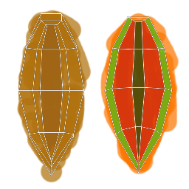
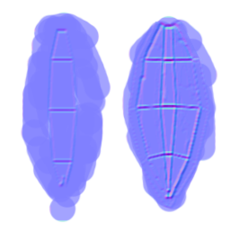
Textures|Asset 1
Paste your images in the green boxes
Diffuse
Specular
(if created)
Normal
Textured Model

Slide 21
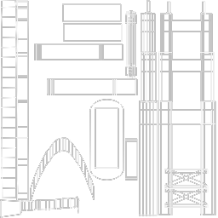
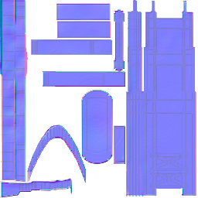
Textures|Asset 2
Paste your images in the green boxes
Diffuse
Specular
(if created)
Normal
Textured Model

Slide 22
Task|Upload
Upload Tasks:
Import your model into the game engine
Apply all required materials and textures.
Adjust the scene lighting and post processing filters.
Take a series of at least three screenshots in engine and paste it into the slide below.
Requirements:
Use appropriate descriptions and tags.

Slide 23
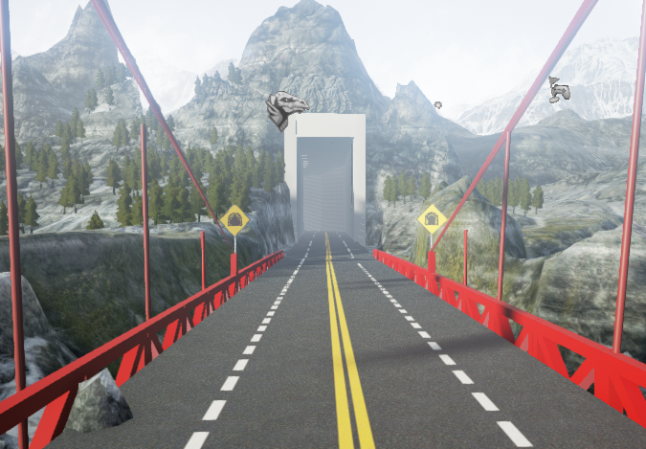
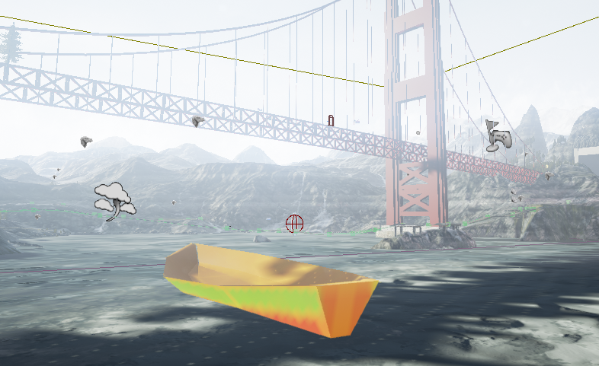
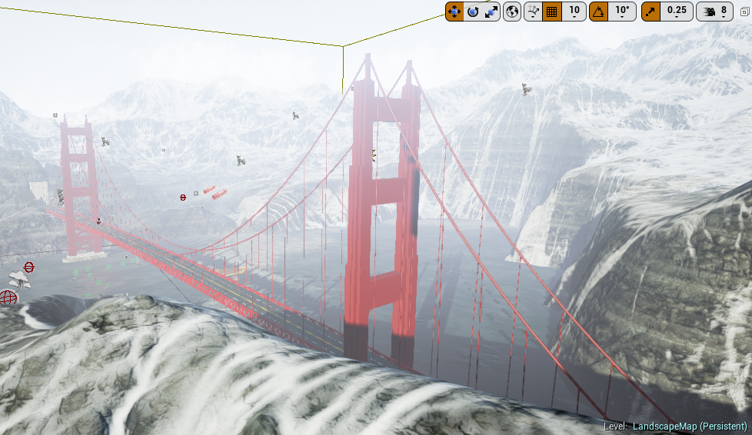
Final Level Shots
Paste your images in the green boxes
Level view 1
Level view 2
Level view 3

Slide 24
Task|Post Mortem
Post Mortem Tasks:
Answer all the questions in the post mortem slide below.
Requirements:
All questions must be answered in sentences (25 Words).
Be sure to check your spelling, grammar and punctuation.

Slide 25
Post Mortem
Did the asset turn out as you expected?, If so how is it different?
Yes, the asset turn out as I expected it has good quality of model and texture.
What was challenging in its creation?
The challenging part in the creation was
What are you most proud of about the asset?
I am very proud that the assets I created as it contain good quality of UV.
What would you do differently?
I would do UV unwrapping and texturing differently because that will make the model look better.
What new skills / things did you learn?
The new skills I learnt in this creation are I learnt to use extruding tool, planner UV tool, Exporting to Unreal Engine with texure.

Slide 26
Feedback|Final
Obtain approval for the final deliverables of the assessment.
Feedback | Approved

Slide 27
Task|Submission
The following files Must be given to your teacher in an appropriate format.
Meshes:
All of your mesh files in both .mb and .fbx format.
YourName_Assess1_AssetName1.ma
YourName_Assess1_AssetName1.fbx
Textures:
Your Photoshop .PSD texture files.
YourName_Assess1_AssetName1.psd
All individual exported texture images in .tga format.
AssetName1_D.tga
AssetName1_S.tga
Level:
Your Unreal files
YourName_ProjectName
Presentation:
Your power point must be submitted to Canvas.
YourName_Assess1_Presentation.ppt

